Slide 1

Fraudulent Transaction Detection
Dixitha Kasturi

Slide 2
Aim
Identify and Predict fraudulent transactions through classification and factors contributing to it

Slide 3
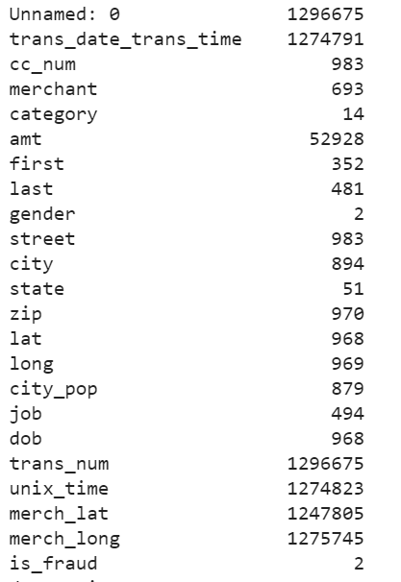
Dataset
Source : Kaggle(Stimulated- Sparkov data generation tool)
Train set ( 1.2 million records,23 columns) Jan 2019-June 2020
Test set (555k records, 23 columns) July 2020 – Dec 2020
Transaction details( Timestamp, amount, location, transaction ID)
Customer details( customer name, dob, location, job, gender, population of city)
Merchant data( Merchant name, location coordinates)
Target variable – is_fraud ( 0 – not fraudulent, 1 – fraudulent)

Slide 4
Approach
EDA
Timeseries EDA
Classification Models
Evaluation of Models
Testing Models

Slide 5
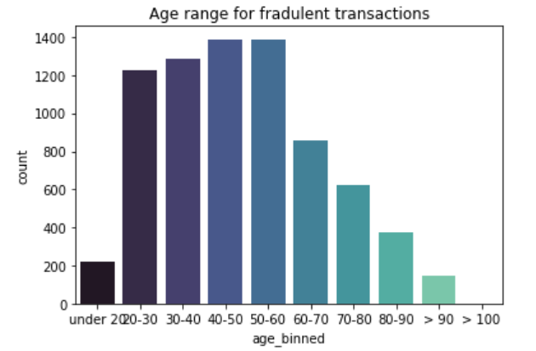
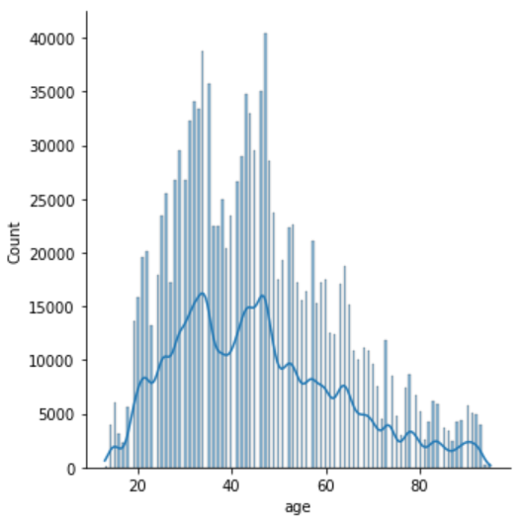
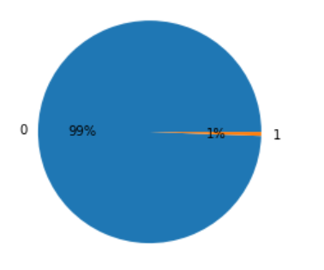
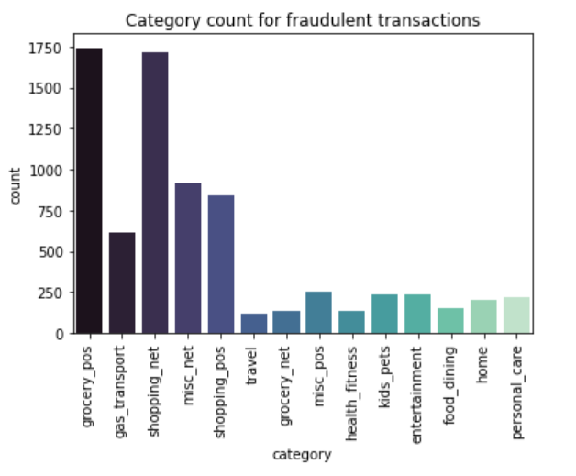
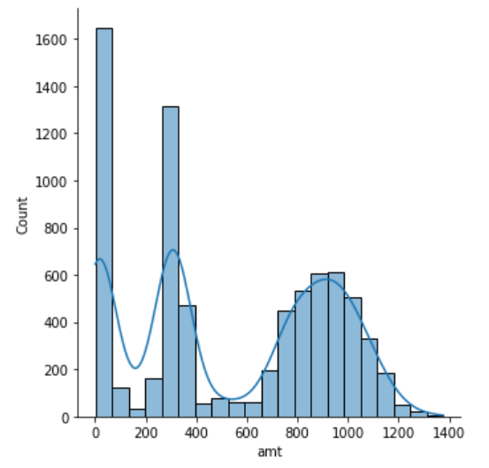
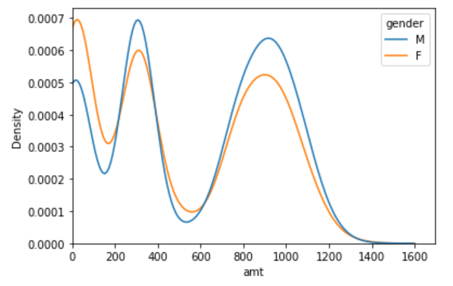
EDA

Slide 6
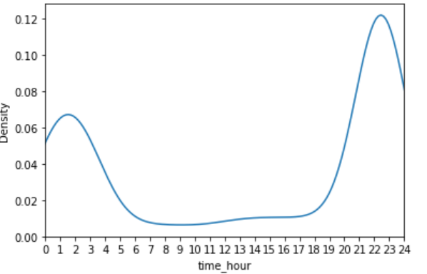
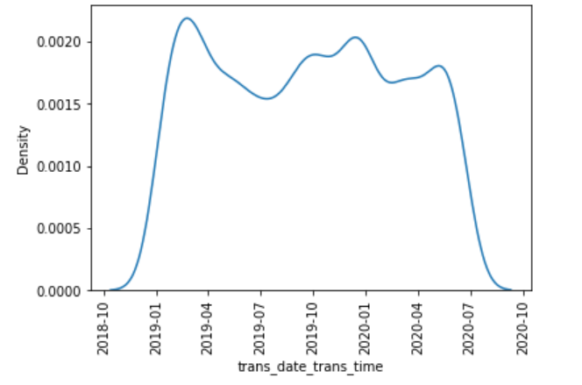
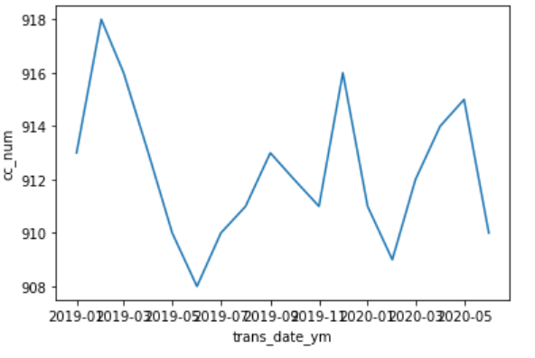
Time Series

Slide 7
Models
Binary Target :
Logistic Regression
SVM
Naïve Bayes
KNN
Parameter Tuning
Cross Validation
Evaluation Metrics
Accuracy
AUC – Area Under Curve of ROC(receiver operating characteristic curve)
Precision and Recall

